Slide 1
Thermal analysis of the diam loop in HM31 and Baffle module 9v analysis
Mikhail Khokhlov
Vojtěch Smolík

Slide 2
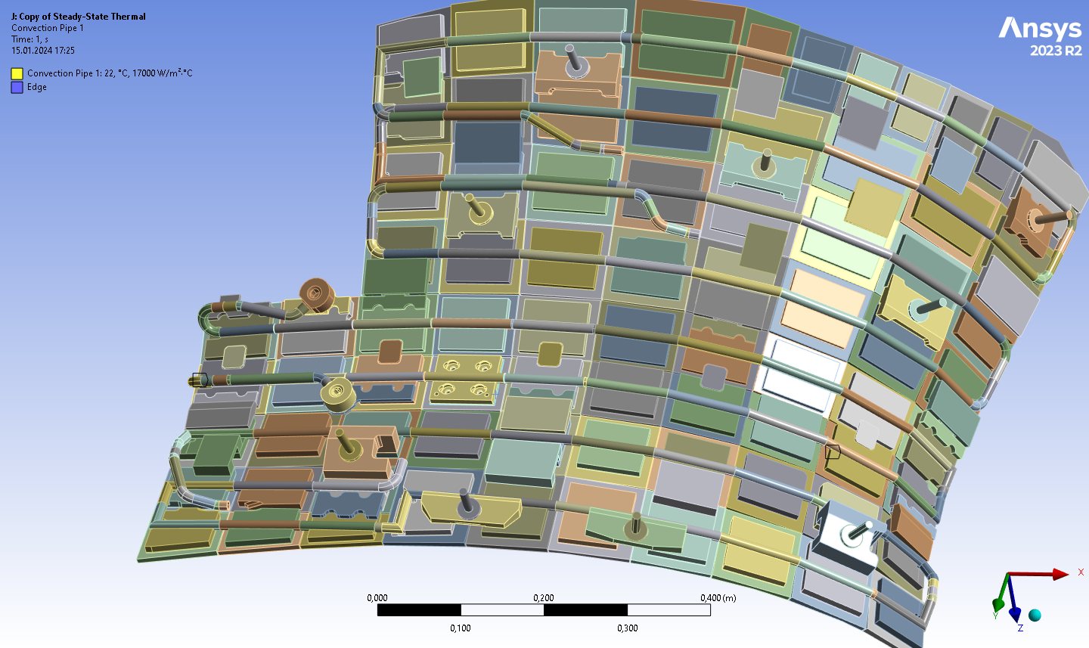
Introduction
Workbench simulation is developed to examine radiation heat load to diam loop in HM31
Cooling water is simulated as a thermal liquid beam –temperature increase along the channel
Steady-state simulation
Uniform heat flux

Slide 3
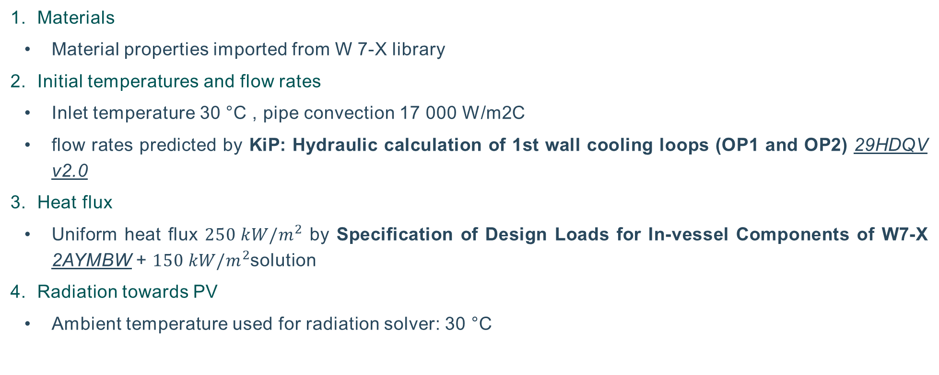
Boundary conditions
Materials
    Material properties imported from W 7-X library
Initial temperatures and flow rates
    Inlet temperature 30 °C , pipe convection 17 000 W/m2C
    flow rates predicted by KiP: Hydraulic calculation of 1st wall cooling loops (OP1 and OP2) 29HDQV v2.0
Heat flux
    Uniform heat flux ${250 kW/m}^{2}$ by Specification of Design Loads for In-vessel Components of W7-X 2AYMBW + ${150 kW/m}^{2}$solution
Radiation towards PV
    Ambient temperature used for radiation solver: 30 °C

Slide 4
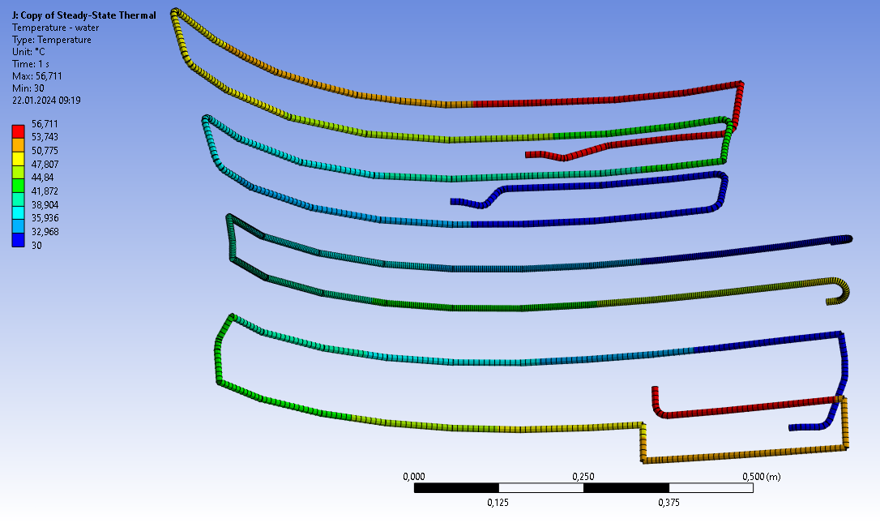
Results: cooling water heat up
 | DT [K] predicted by 29HDQV v2.0 | DT [K] Workbench result 250 kW/m2 | DT [K] Workbench result 150 kW/m2 | Flow rate [l/s]
H77 1-ACH31AC610b | 10 | 18,5 | 11,1 | 0,48
H34 1-ACH31AC560b | 16 | 27,1 | 16,4 | 0,45
H81 1-ACH31AC570b | 19 | 27,1 | 16,4 | 0,7
H81 1-ACH31AC570b
H77 1-ACH31AC610b
H34 1-ACH31AC560b

Slide 5
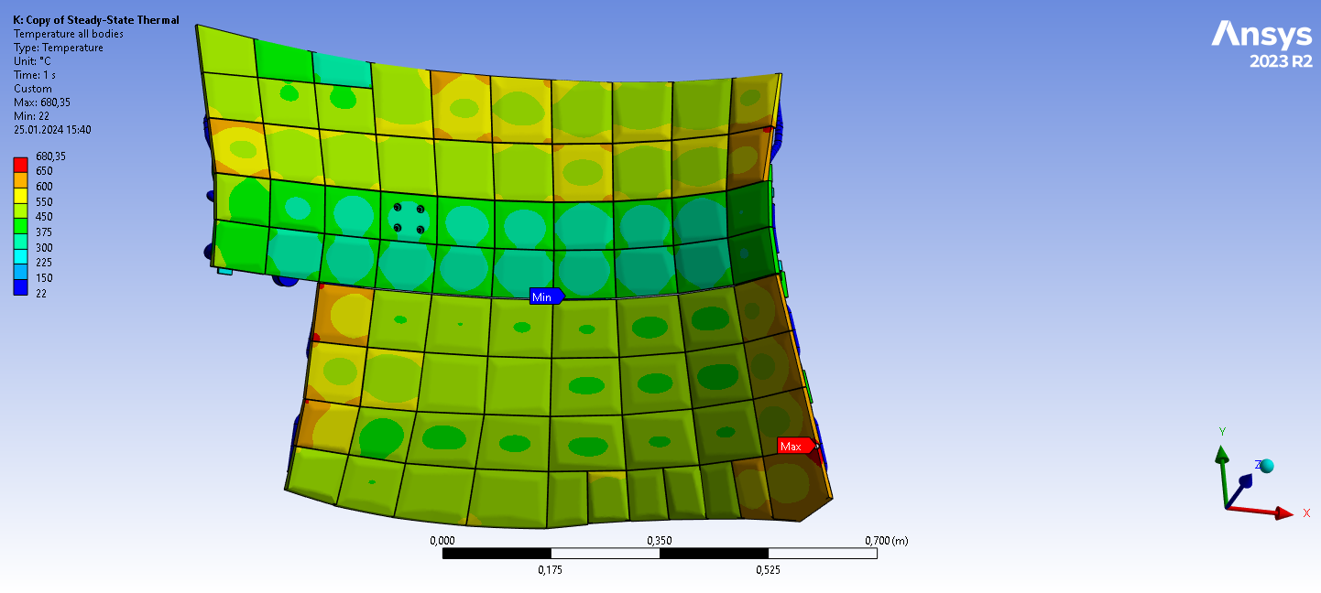
Results temperatures in HSs - 250 kW/m2

Slide 6
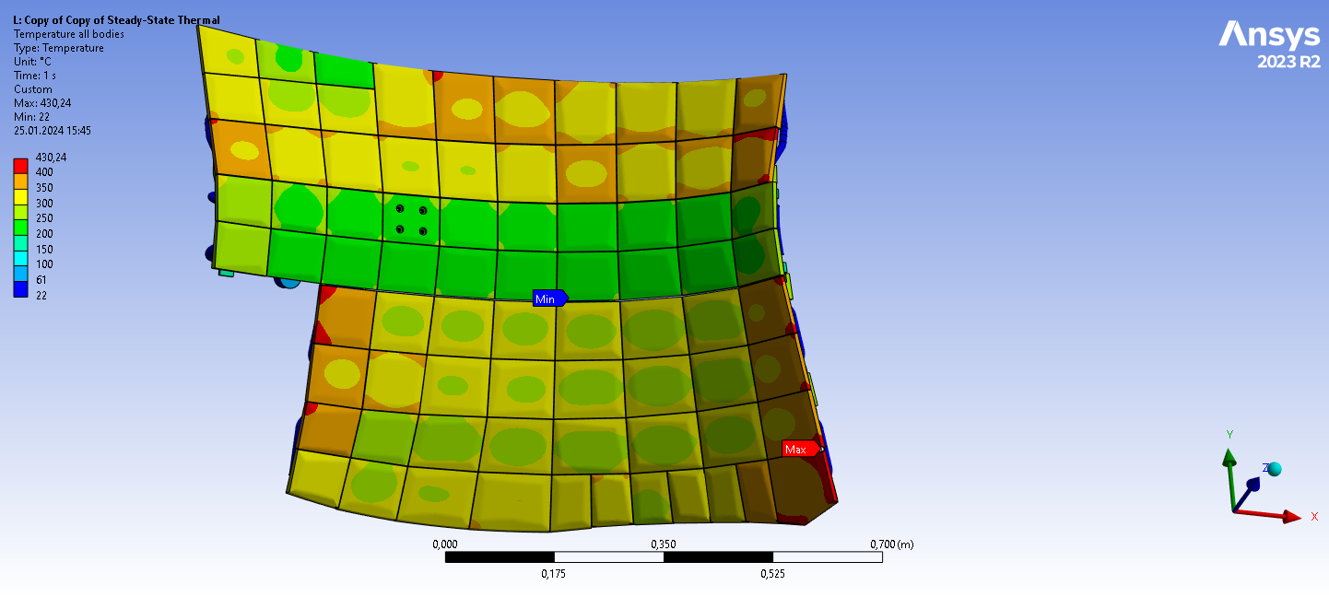
Results temperatures in HSs - 150 kW/m2

Slide 7
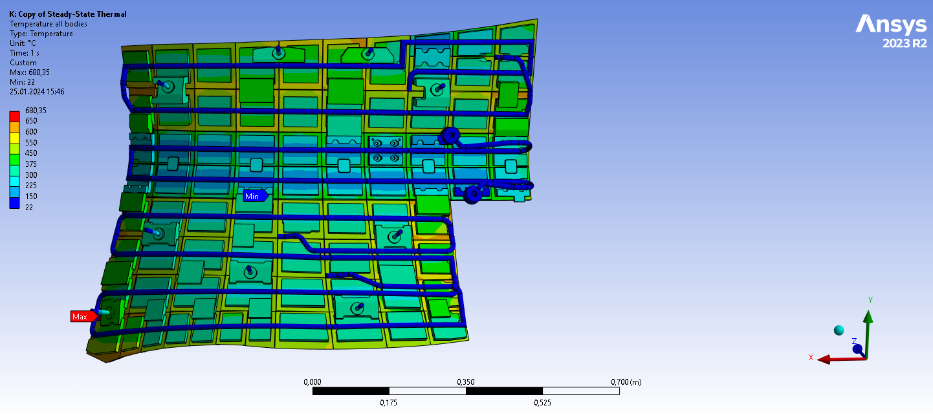
Results temperatures in HSs - 250 kW/m2

Slide 8
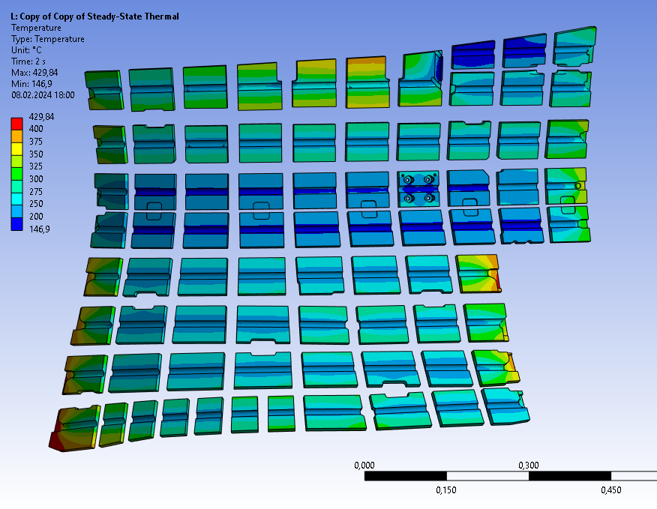
Results temperatures in HSs - CuCrZr - 250 kW/m2

Slide 9
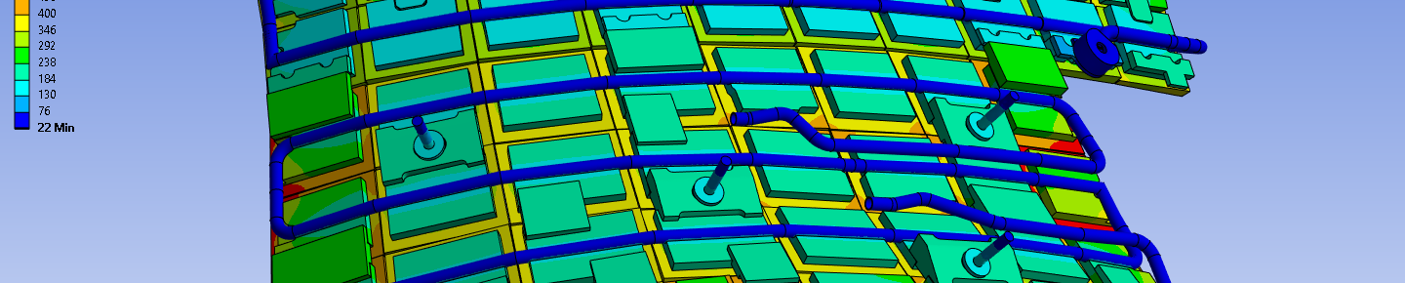
Results: Heat balance & radiation towards PV – 250 kW/m2
 | PF heat [W] | Ratio of PF heat | Area [m2] | avg. rad. heat flux [W/m2]
PF heat | 171 172,5 | 100% | 0,68469
Convection - cooling pipes | -167658 | 97,9% | 0,24492 | -
Convection - in/outlet areas of cooling pipes | -104,44 | 0,06% | 0,00999 | -
Radiation – graphite | -3116,9 | 1,82% | 0,25607 | 12172
Radiation – CuCrZr | -231,654 | 0,13% | 0,28789 | 804
Radiation – pipes | 106,431 | 0,06% | 0,14005 | 760
Radiation – connector plates | -111,531 | 0,06% | 0,10799 | 1032
Conduction – supports to vessel | -26,7 | 0,01% | 0,0007 | -
SUM | 29,66 | - |  | 4234,41

Slide 10
Results: Heat balance & radiation towards PV – 150 kW/m2
 | PF heat [W] | Ratio of PF heat | Area [m2] | avg. rad. heat flux [W/m2]
PF heat | 102 703,5 | 100% | 0,68469
Convection - cooling pipes | -101 494 | 98,8% | 0,24492 | -
Convection - in/outlet areas of cooling pipes | -63,3 | 0,06% | 0,00999 | -
Radiation – graphite | -1014,11 | 1,8% | 0,25607 | 3960
Radiation – CuCrZr | -96,38 | 0,13% | 0,28789 | 334
Radiation – pipes | -39,07 | 0,03% | 0,14005 | 279
Radiation – connector plates | -45,19 | 0,04% | 0,10799 | 418
Conduction – supports to vessel | -26,7 | 0,04% | 0,0007 | -
SUM | -17,04 | - |  | 1409

Slide 11
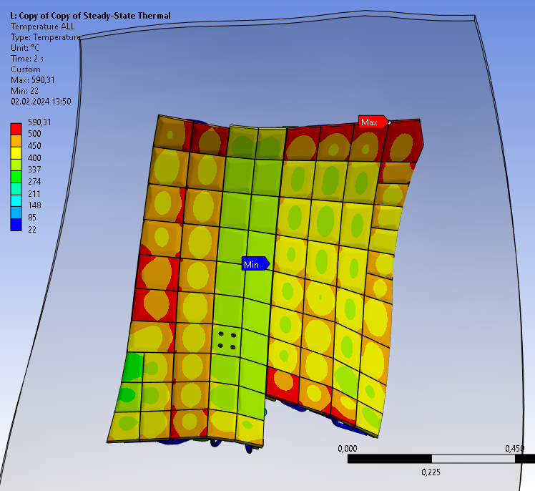
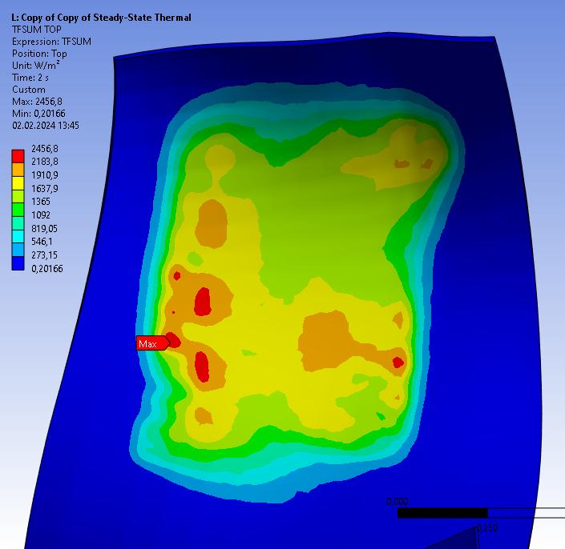
PV Heat flux – without bolts connecting HS to PV- 250 kW/m2

Slide 12
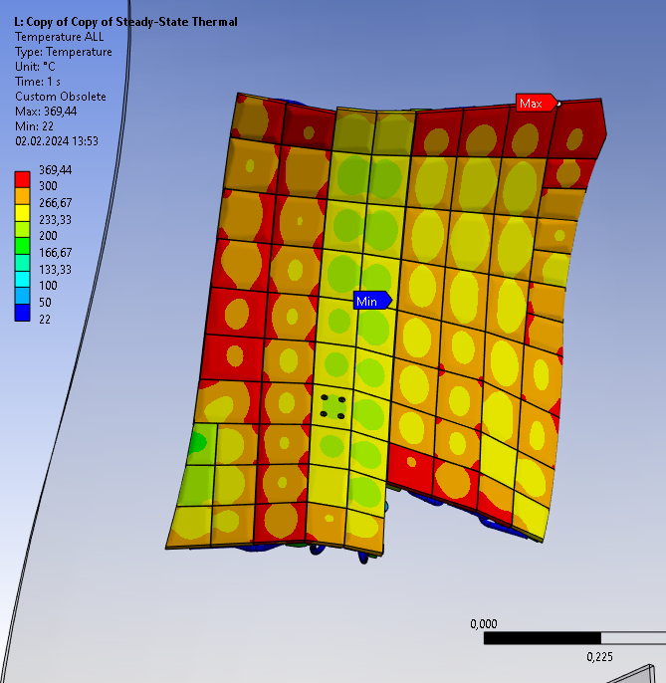
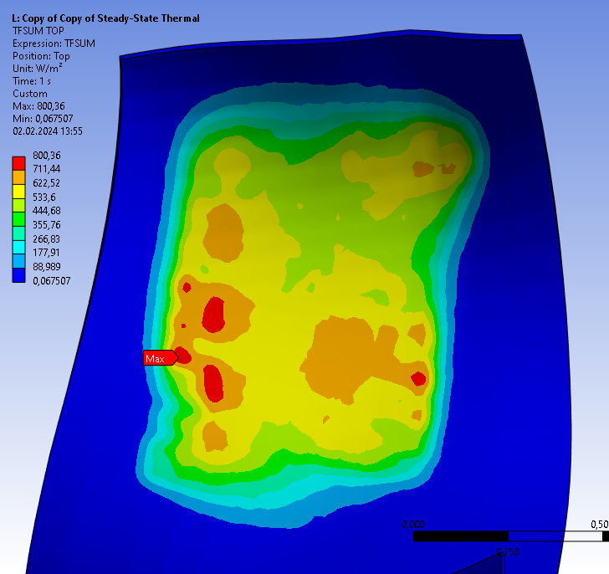
PV Heat flux – without bolts connecting HS to PV - 150 kW/m2

Slide 13
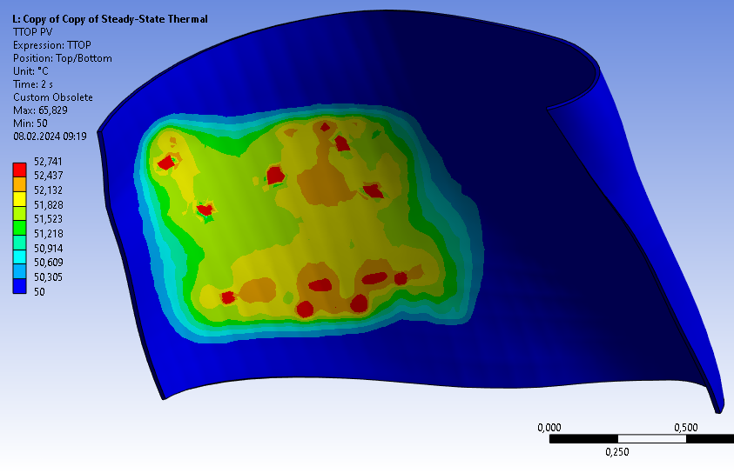
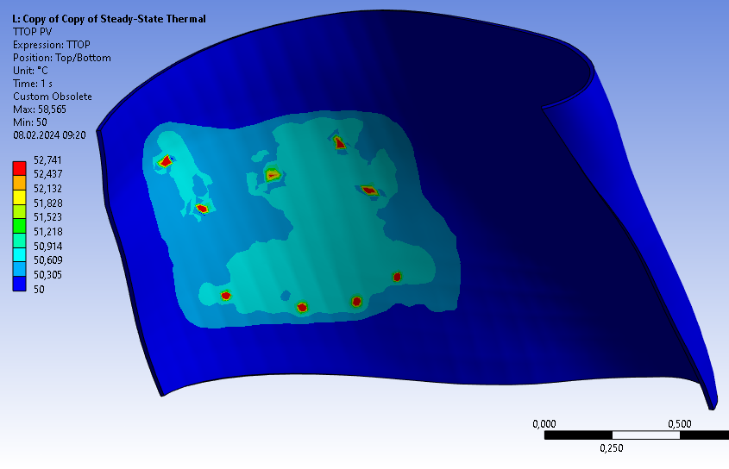
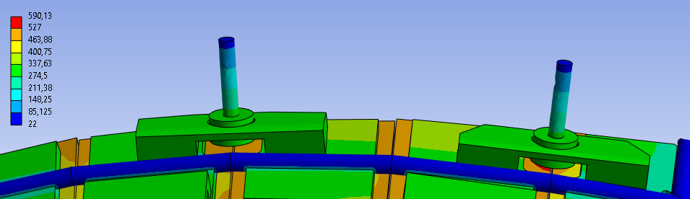
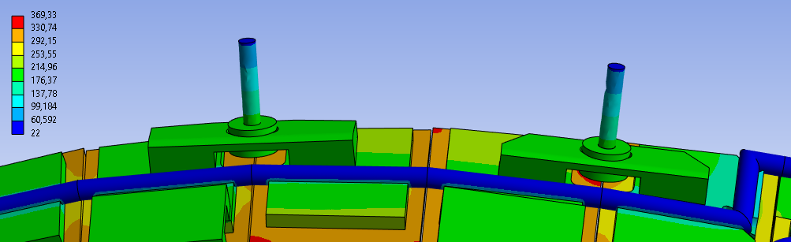
PV Temperature – with bolts connection to the PV
250 kW/m2
150 kW/m2

Slide 14
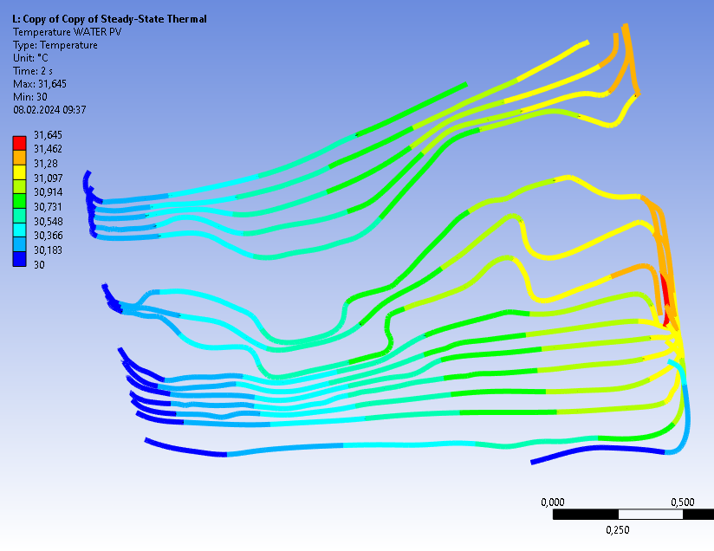
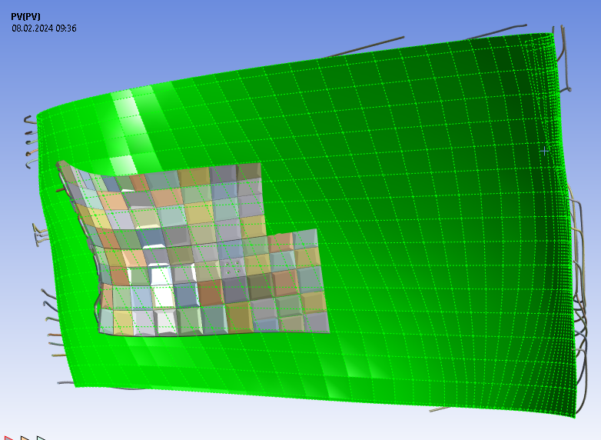
PV added to the simulation
PV cooling water (250 kW/m2)

Slide 15
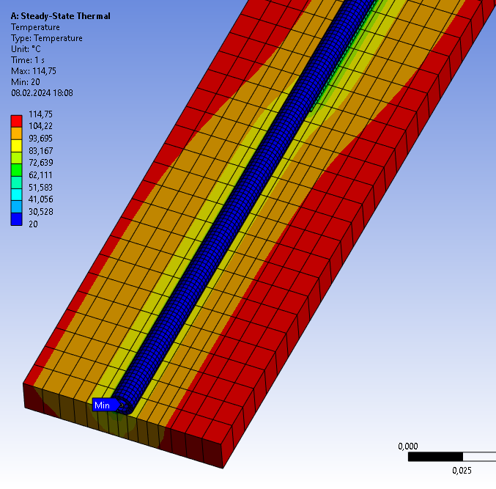
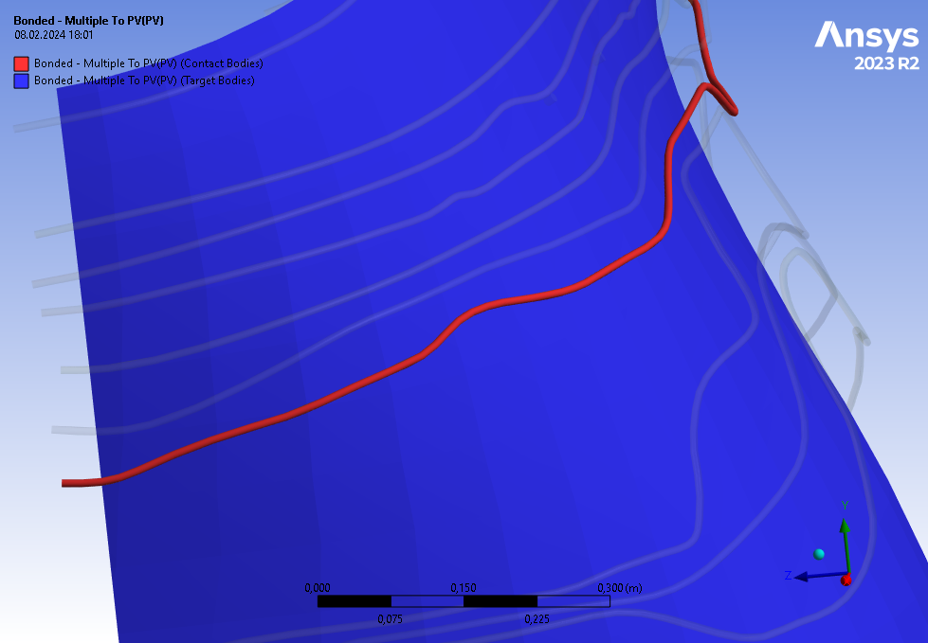
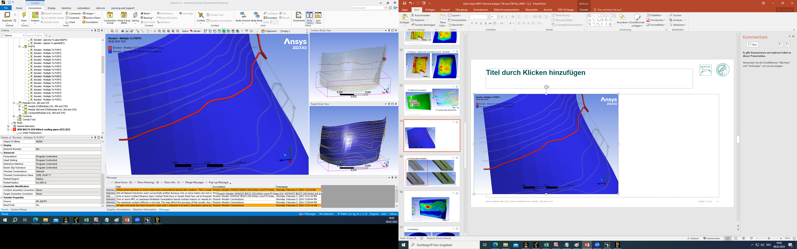
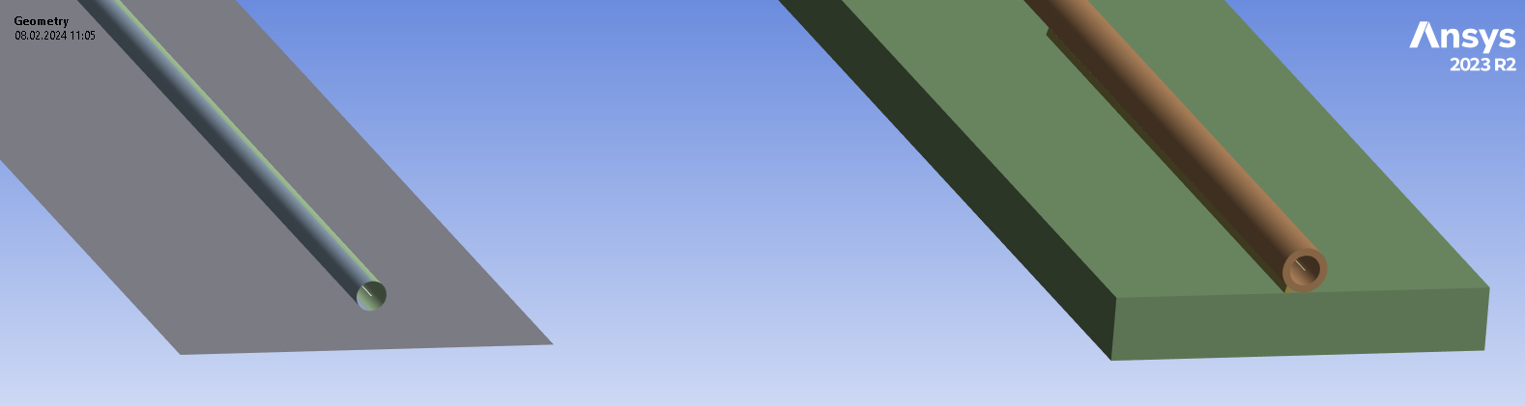
Welding the PV cooling pipes
Simplified geometry used for solution
Actual geometry

Slide 16
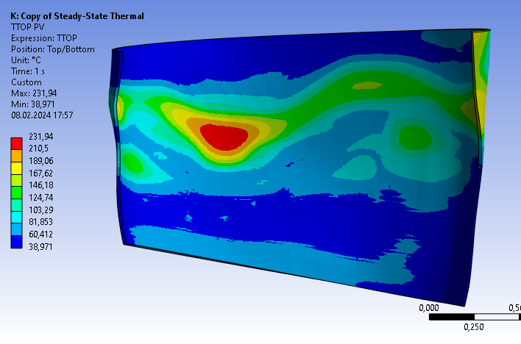
PV with cooling pipes - temperature profile

Slide 17
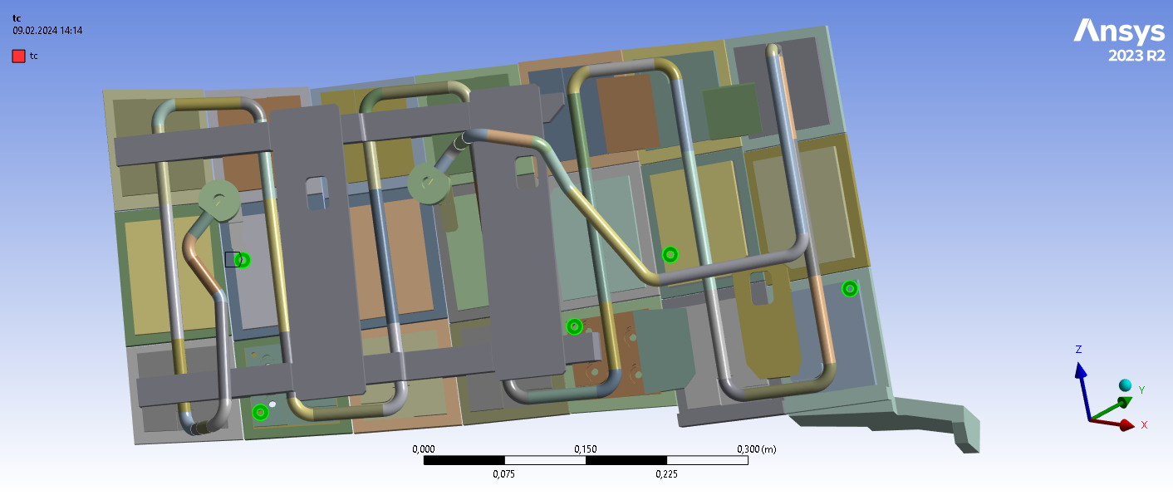
Baffle module 9v transient analysis
to evaluate the relation between heat sink thermocouple measurements and heat flux load
surface temperature measurements of BM 9v available

Slide 18
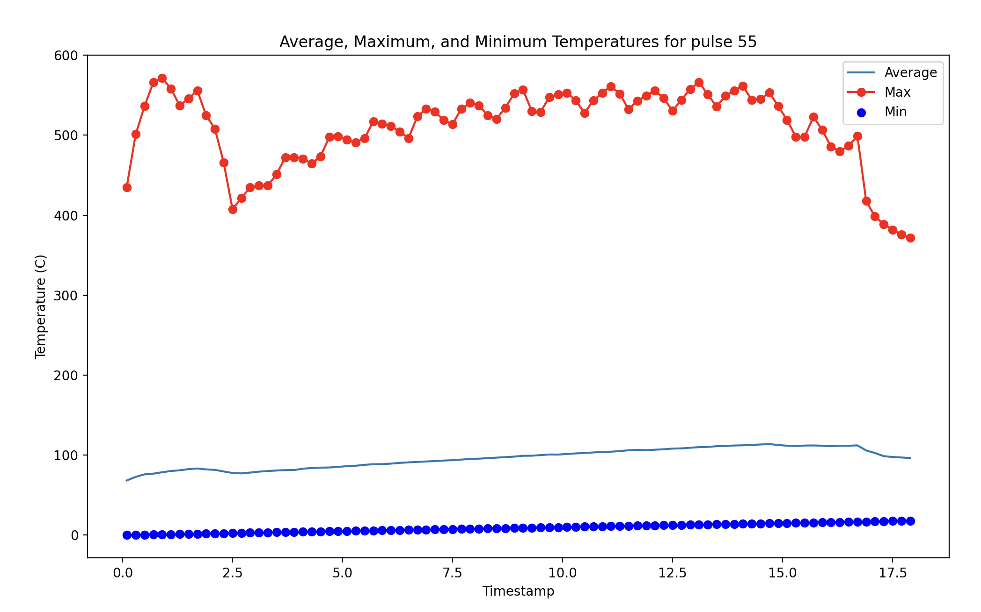
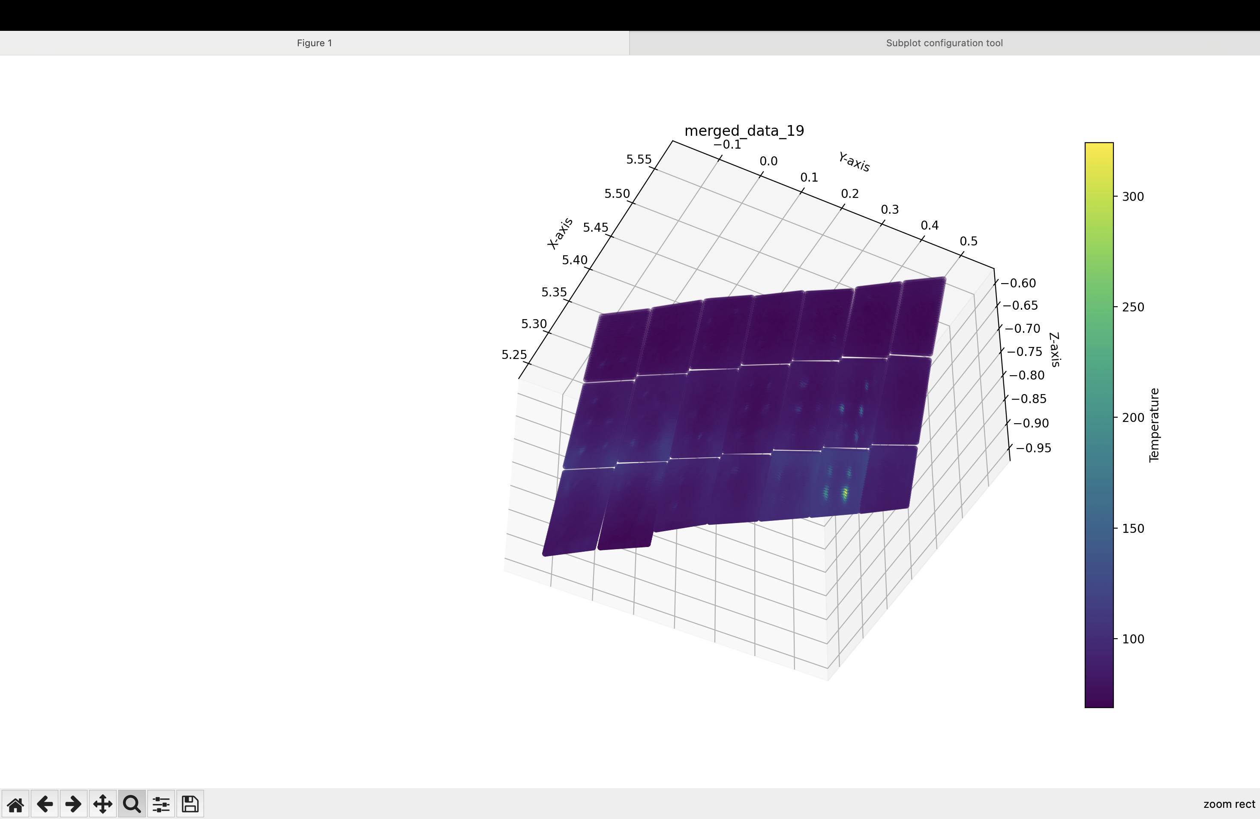
Importing the temperature profile of graphite surface

Slide 19
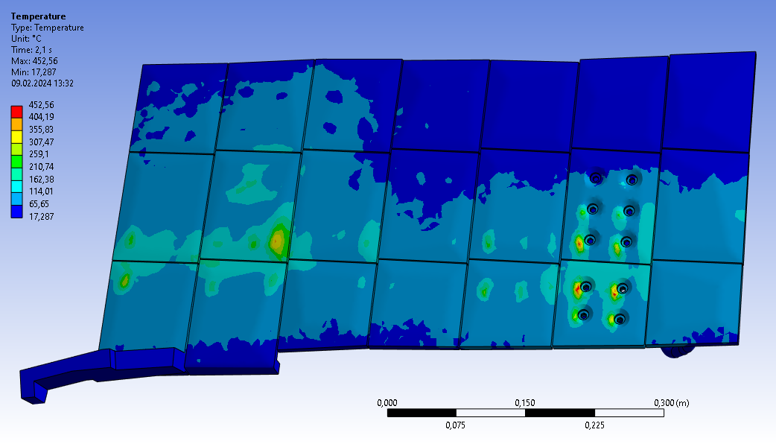
Issue #1 - Bolts positions are not properly matching

Slide 20
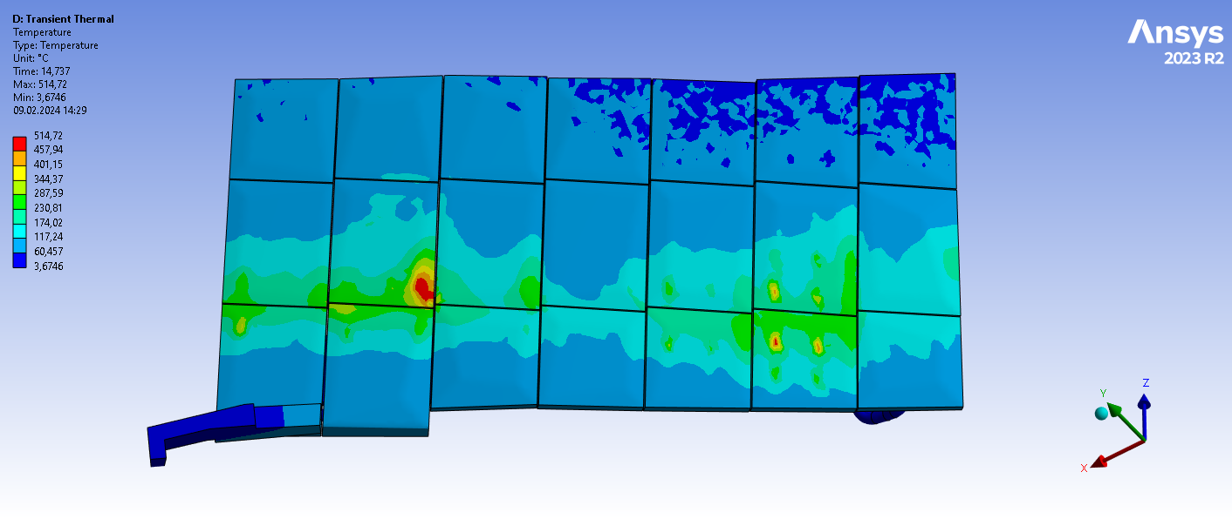
Imported surface temperature profile
Visible convective load area

Slide 21
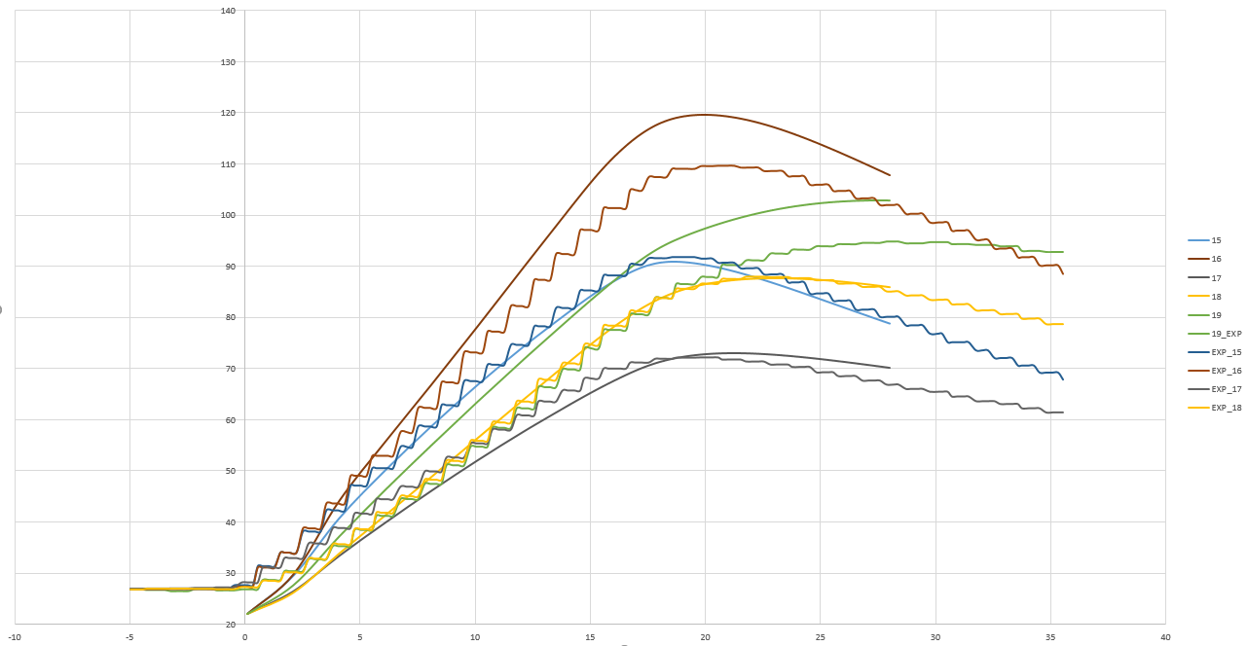
Thermocouple results validation
Thermocouple temperature – experimental vs simulation

Slide 22
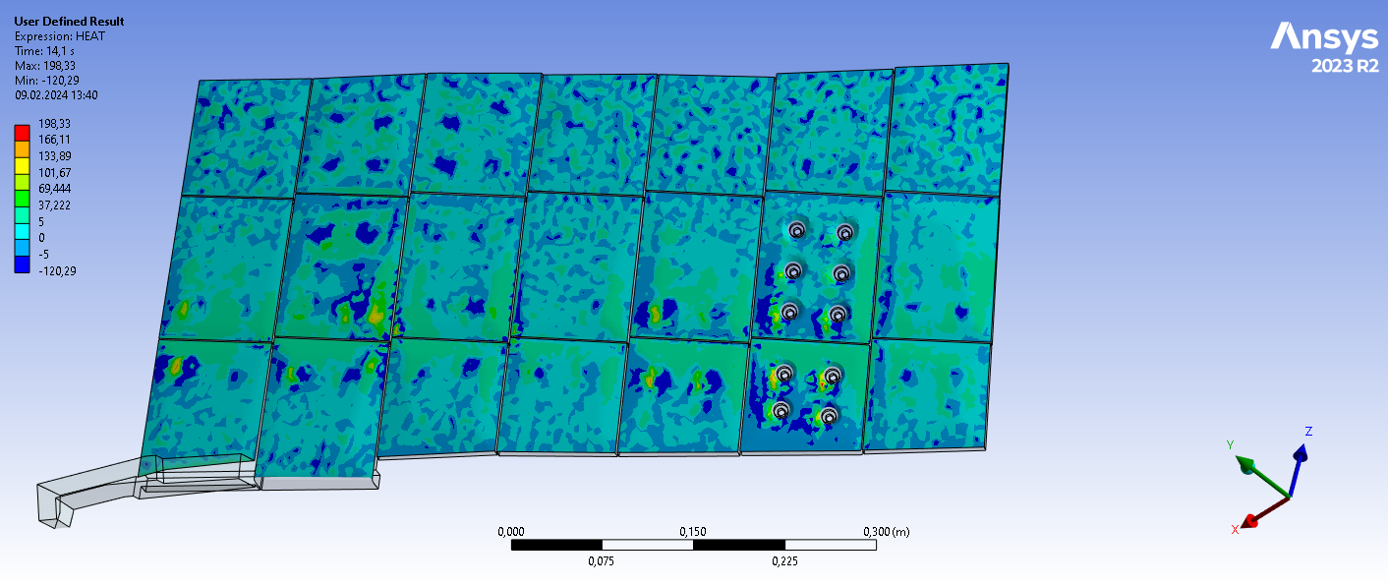
Issue #2 – How to evaluate the heat flux profile

Slide 23
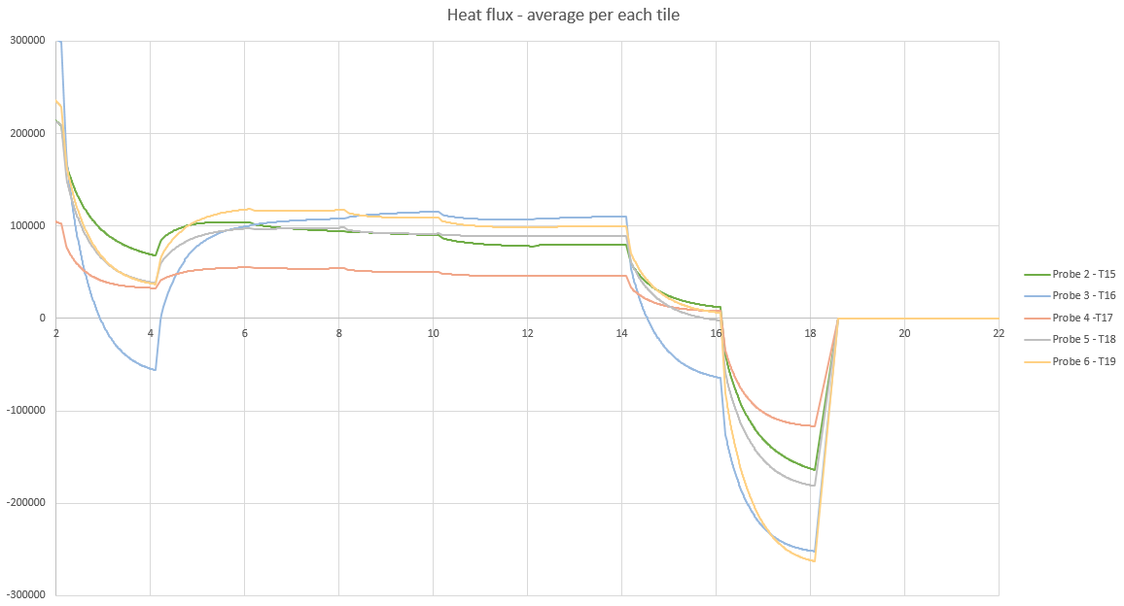
Heat flux results – average per tile

Slide 24
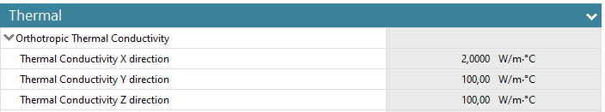
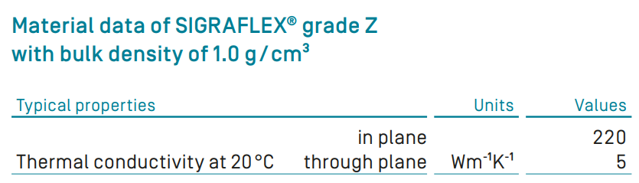
Questions
Sigraflex thermal conductivity
BM_materials definition:
(used for presented sim.)
3 W/mC
SGL carbon manufacturer :
The quality of thermal contact between sigraflex and graphite/crcrzr

Slide 25
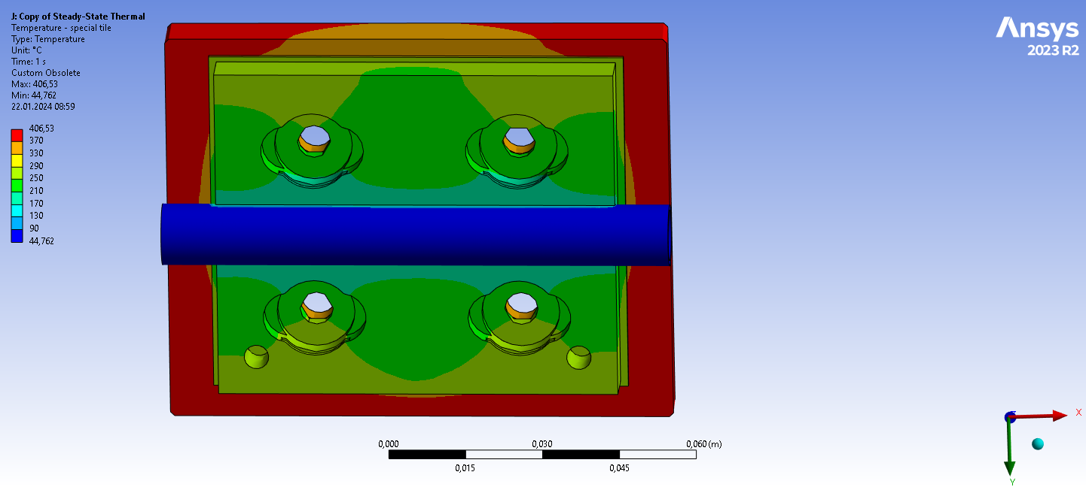
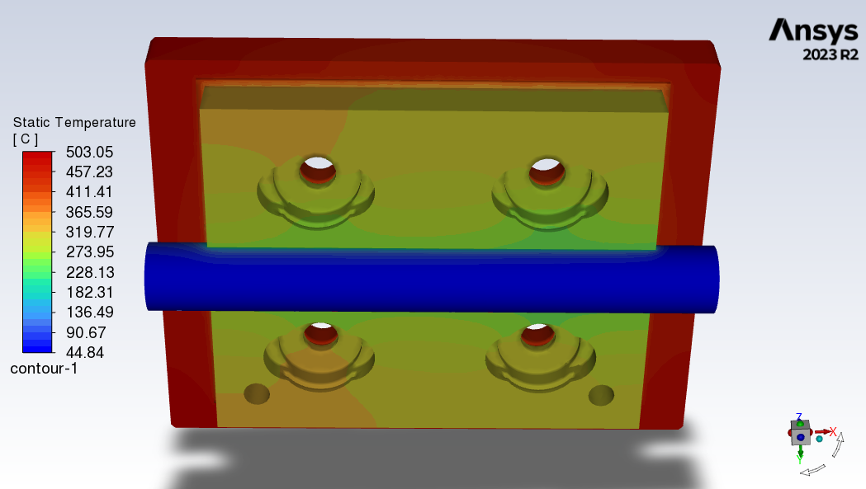
Comparison one tile Workbench vs. Fluent - 250 kW/m2
Workbench
Fluent

Slide 26
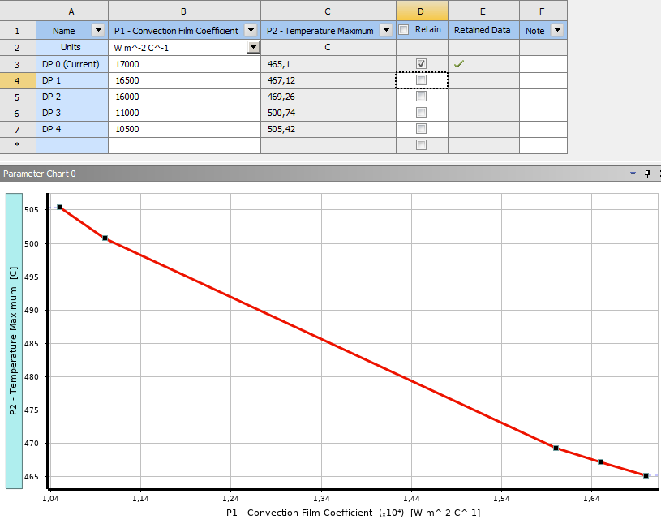
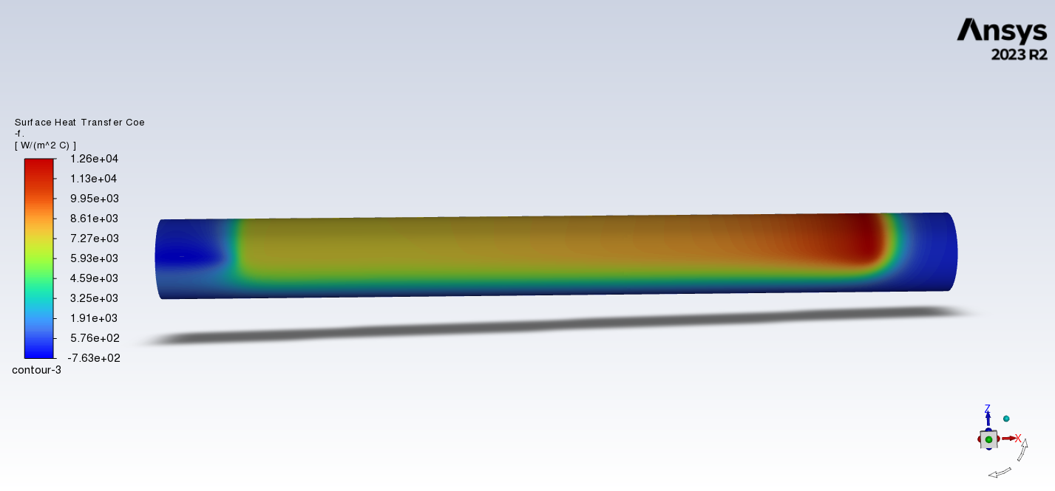
Questions
Film coefficient for water cooled pipes, reference: Heat transfer coefficients for turbulent pipe flows, Andre Carsl, 1-ACH00AC400 , -T0002.0
- used coeff.: 17 000 W/mK
Fluent result - HTC
HTC 10 500 W/m2/K applied to Workbench simulation = Workbench results match Fluent simulation

Slide 27
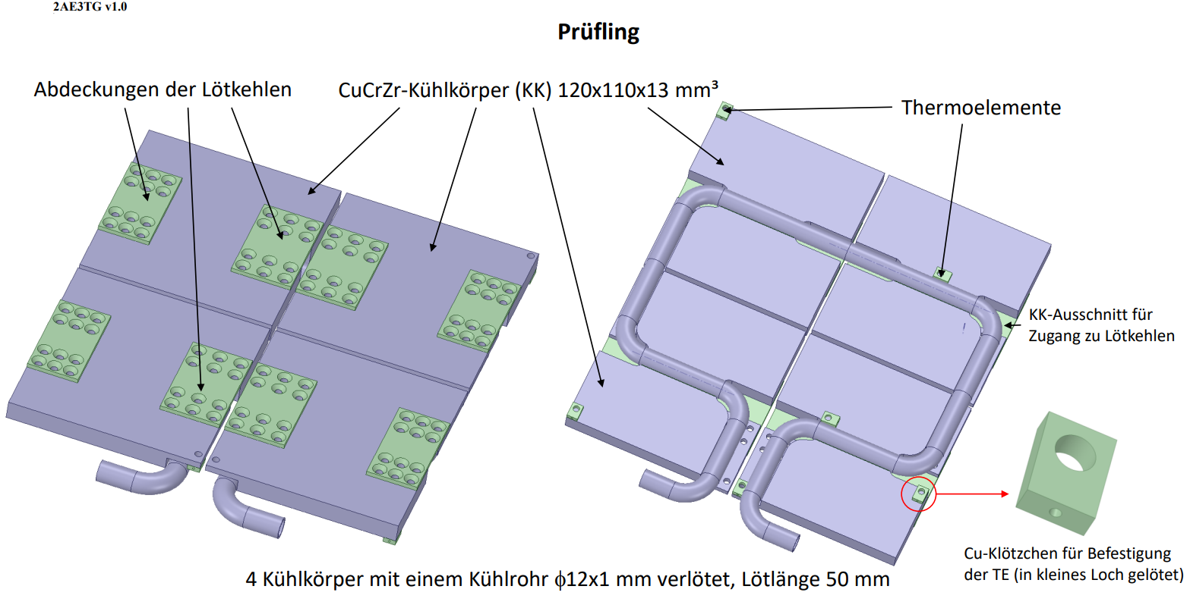
Zyklischer Belastungstest einer Baffle-Probe

Slide 28
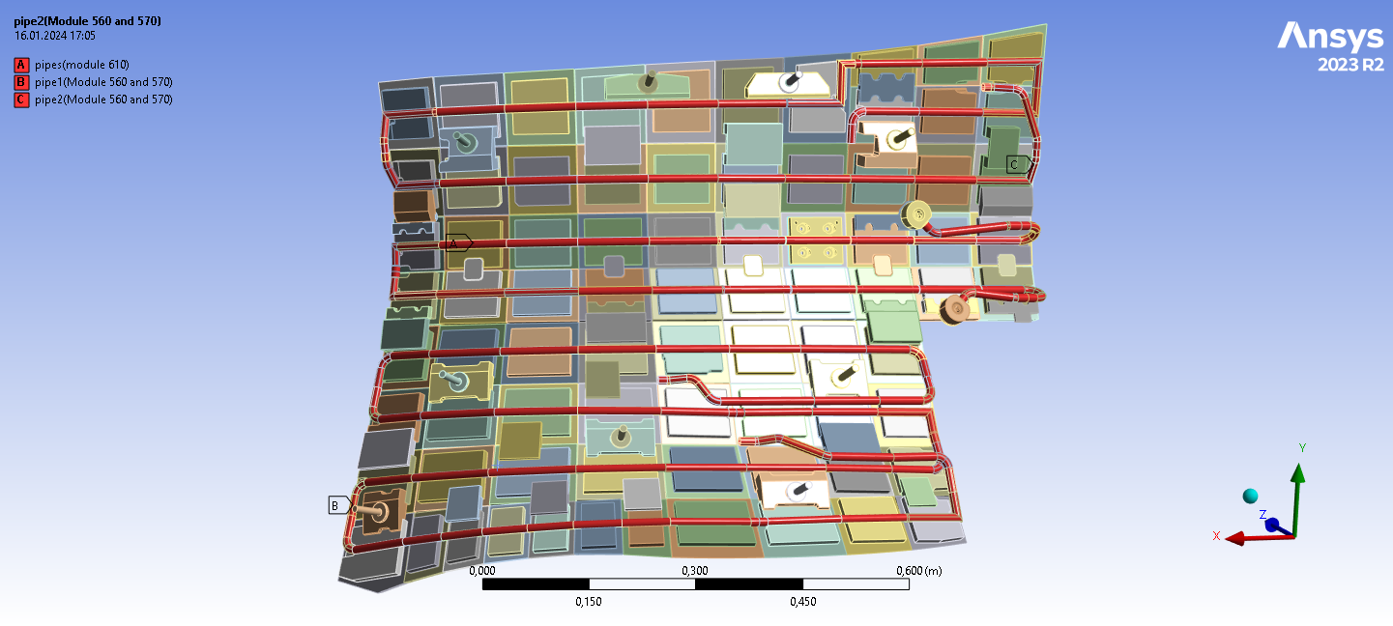
Questions
INLET / OUTLET positions
INLET
INLET
INLET

Slide 29
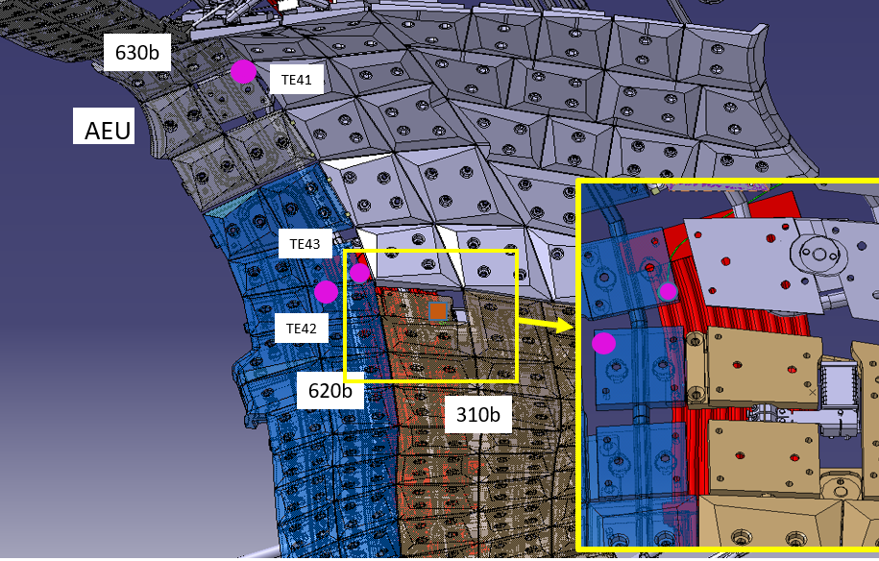
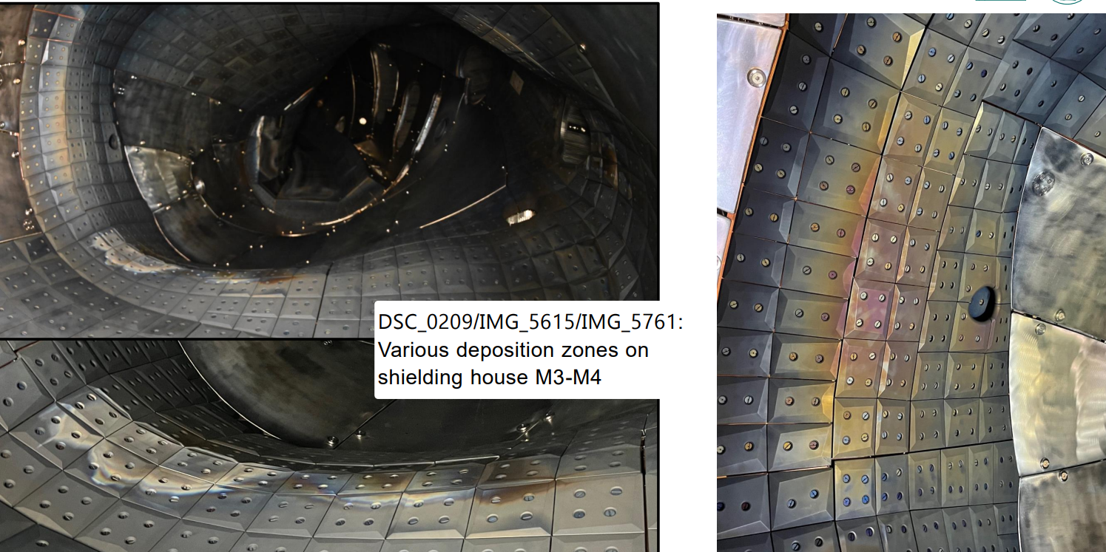
Questions
Thermocouple measurement data and positions
    do we really have thermal sensors only in the tip of triangle shaped area?

